Slide 1
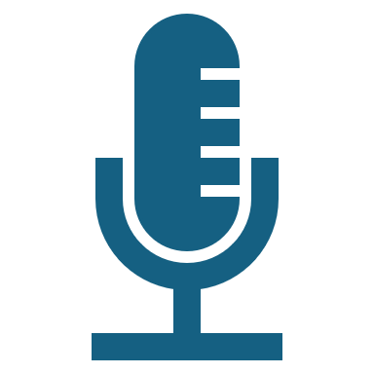
Voice BOT
Shikha Agrawal

Slide 2
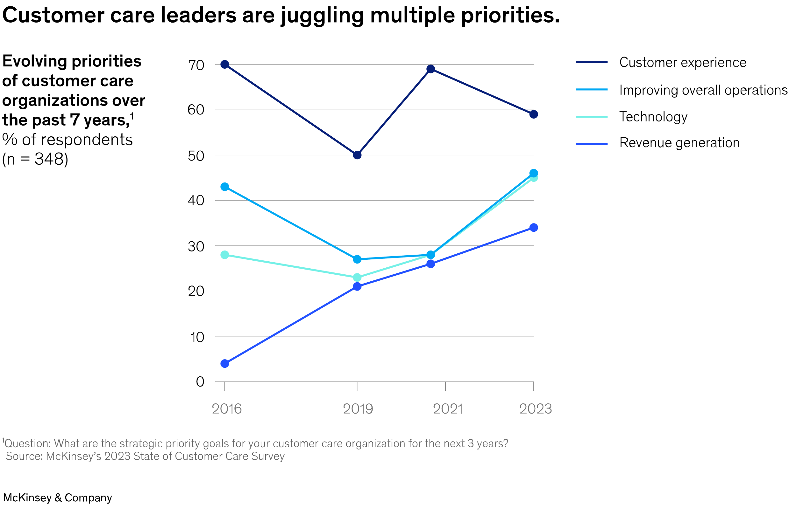
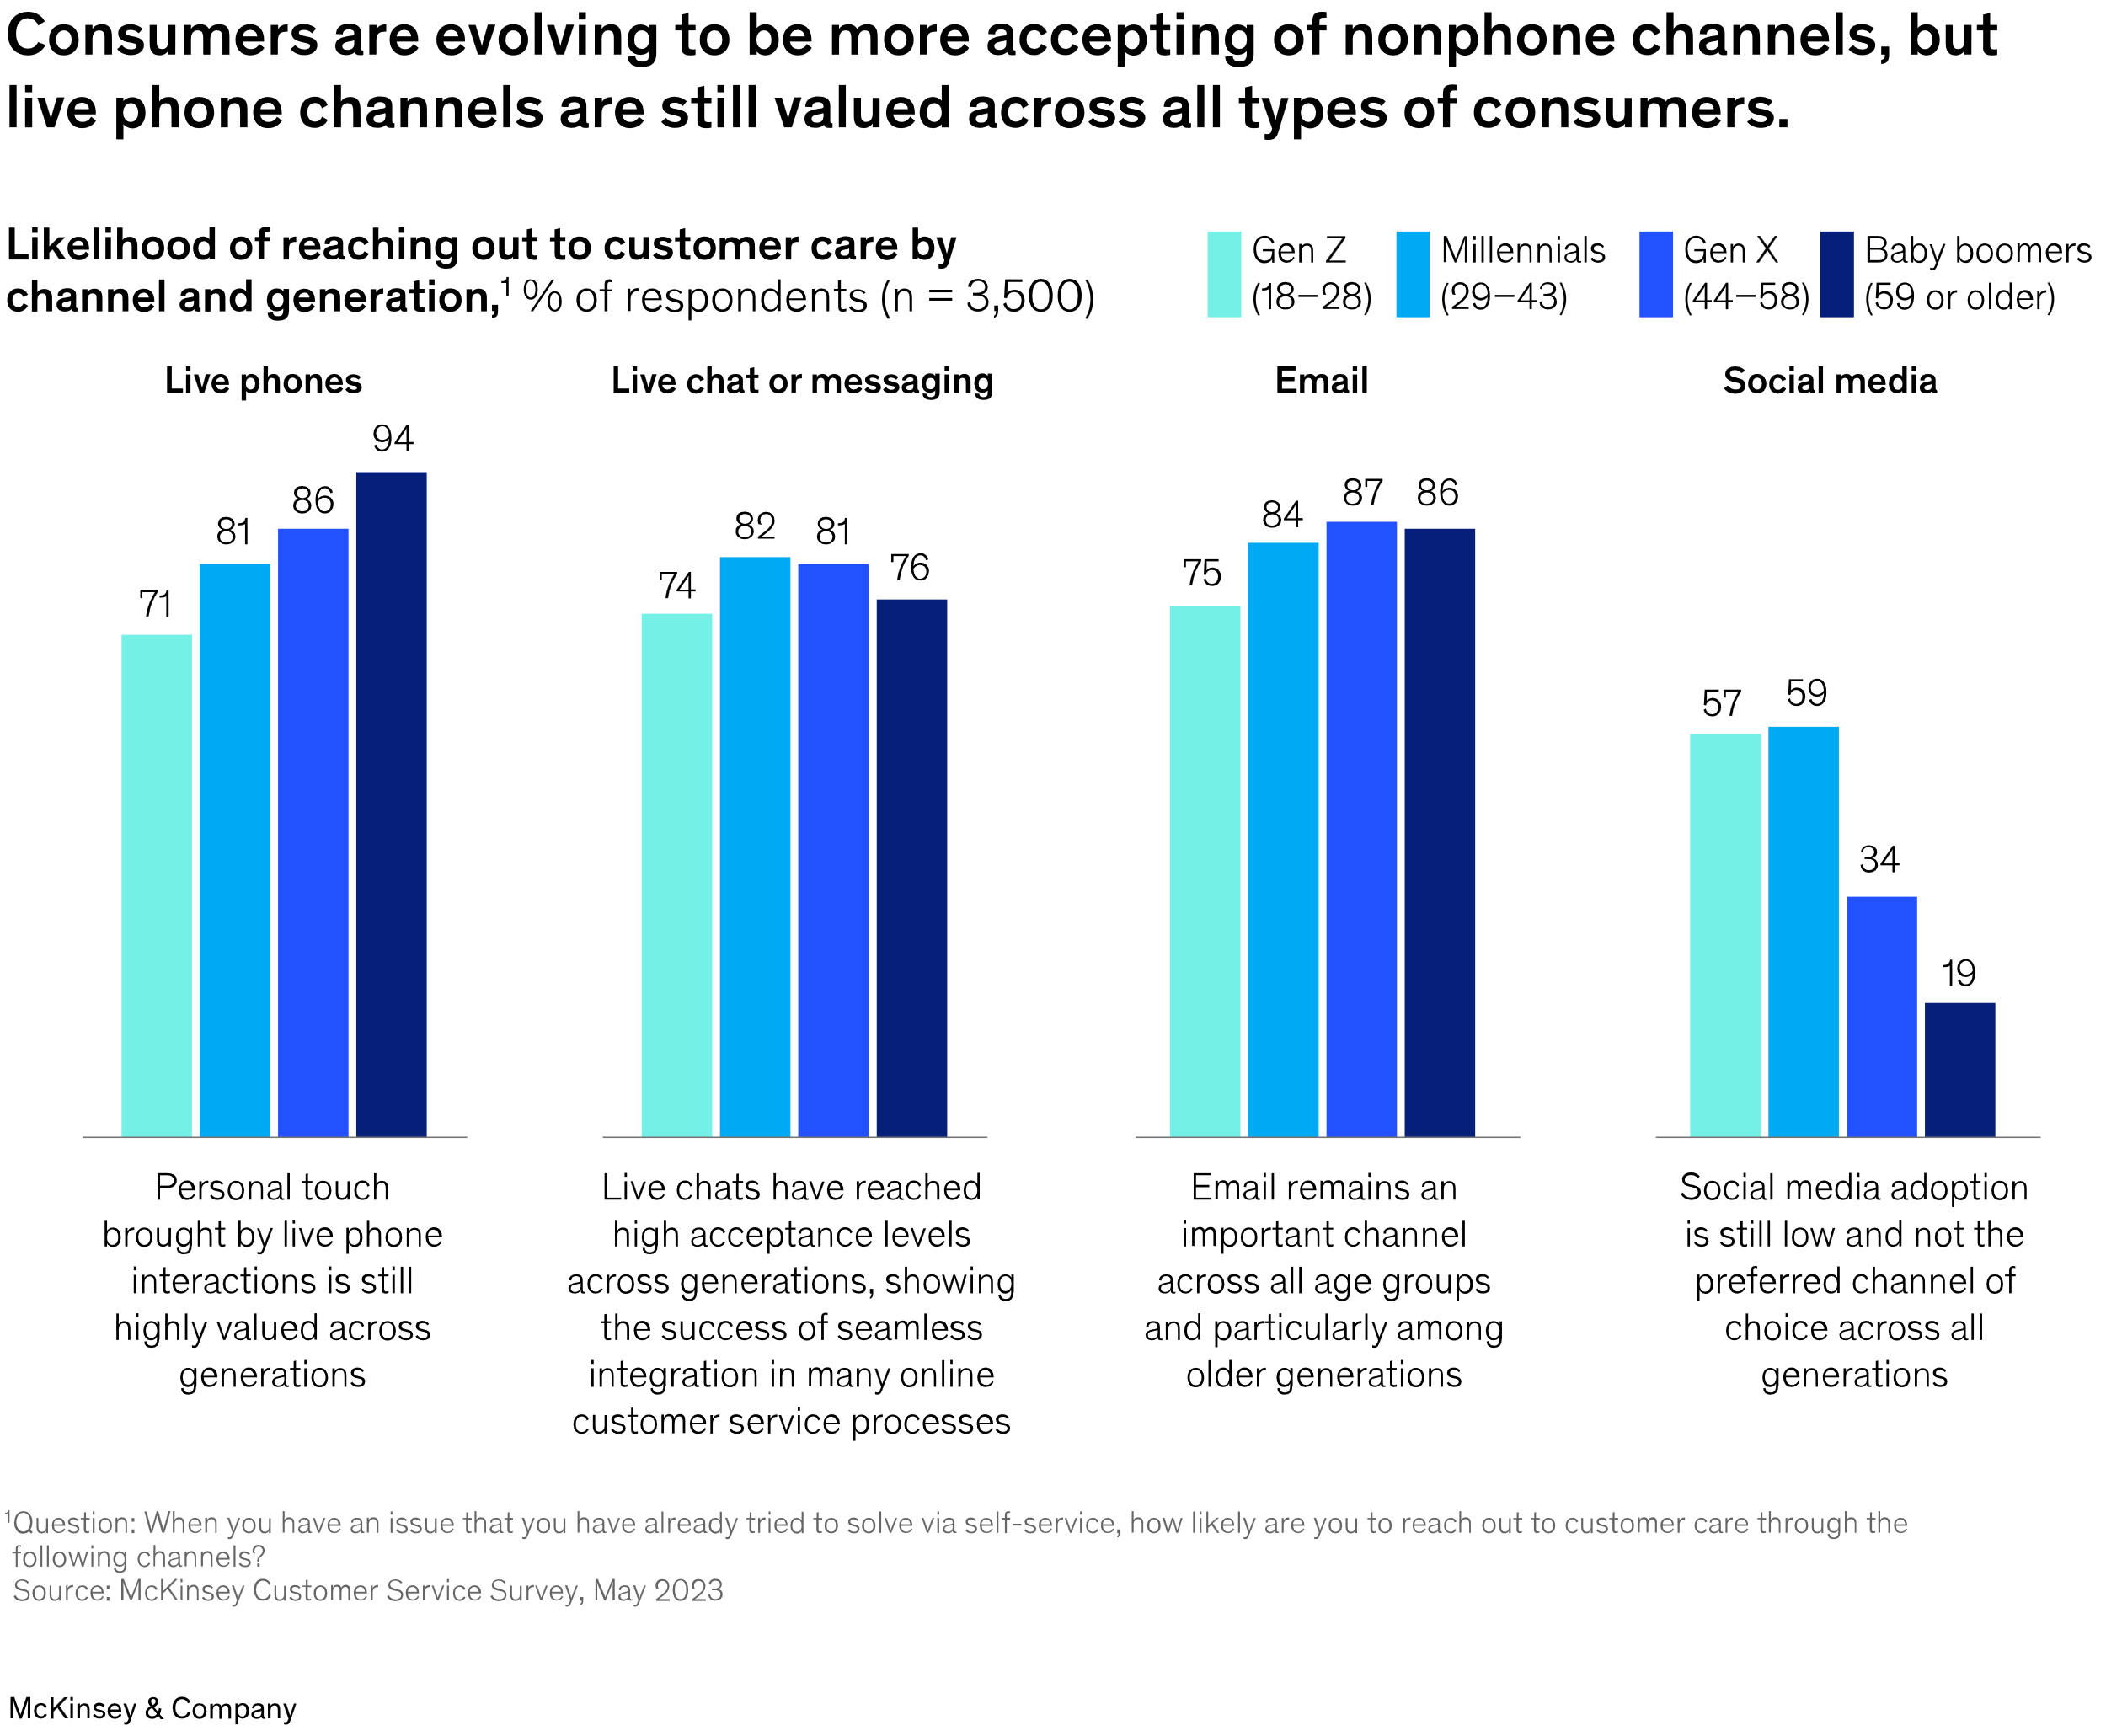
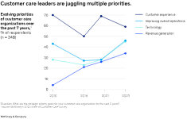
Customer Care - Market Research
Top of Mind for
Customer Care
Leaders`
Meet tough commercial Targets
Key Aspirations for
AI Steered
Customer care
Hyper efficient
Responsiveness
Current State of
Call Centers &
Need of the hour
Traditional call centers thing of the past
Underperformance of digital models is the norm
Meet rising customer expectations
Retaining Personal Contact
Need to master ways performance improvement
Very few have exceptional digital customer care
Expectation high from Successful models
Boost capabilities by investing in employee upskilling
Tech driven operational improvements
Prepare organization for AI Enabled Future
Training for agents
Chatbots
Automated Email Response
Social media analytics
AI Interventions
Ref Where is customer care in 2024? | McKinsey

Slide 3
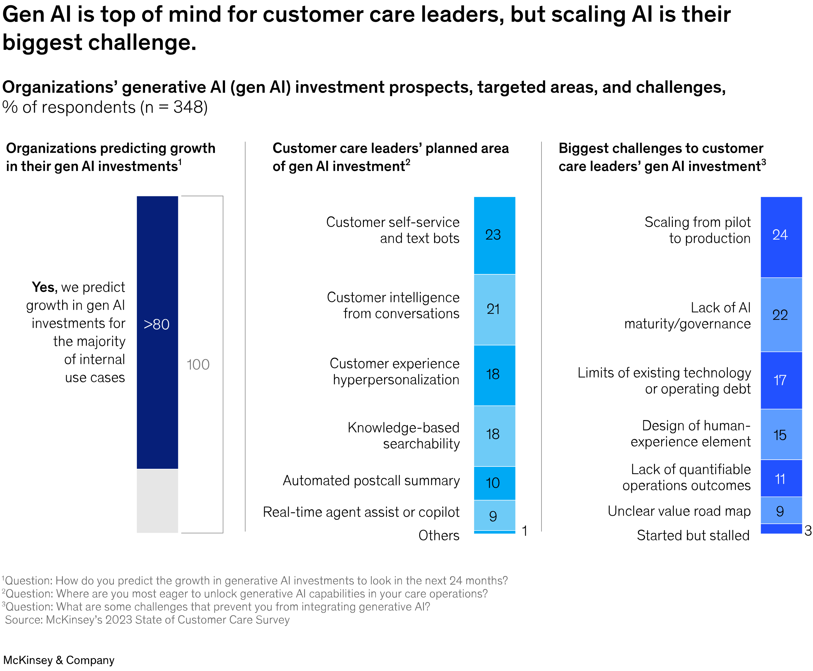
Customer Care – Current State of AI Adoption
Gen AI customer care revolution is still in its early stages
Top performers have seized the opportunities presented by AI
With ruthless prioritization, invested capital to drive efficiency & service excellence in cx journey
Others are struggling to fit a patchwork of digital point solutions into legacy care ecosystems
Notes:
virtual assistants, agent-assist tools, and AI-powered voice analytics

Slide 4
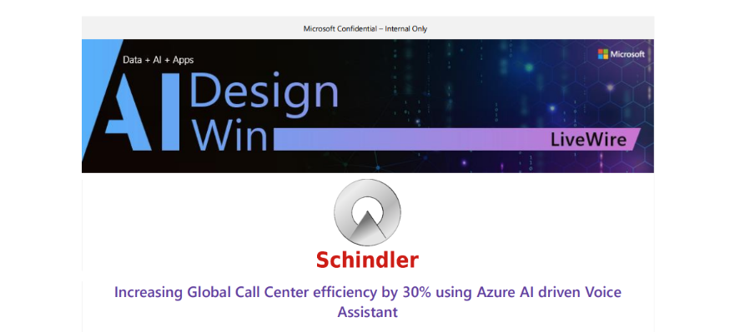
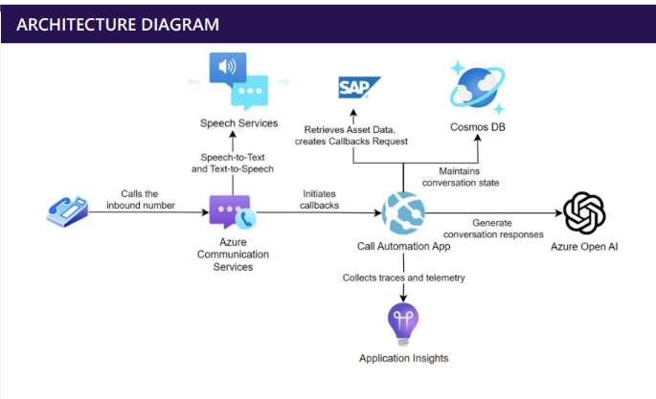
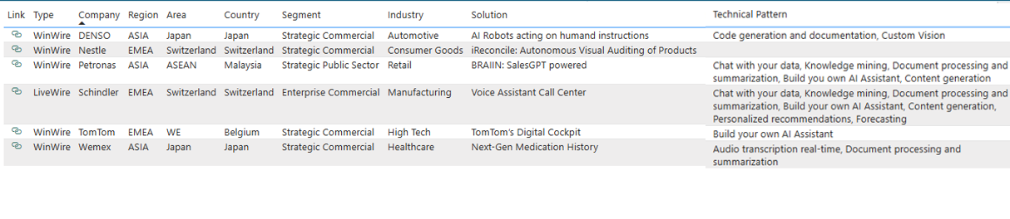
Winwires and LiveWires for Voice BOTS
Notes:
virtual assistants, agent-assist tools, and AI-powered voice analytics

Slide 5
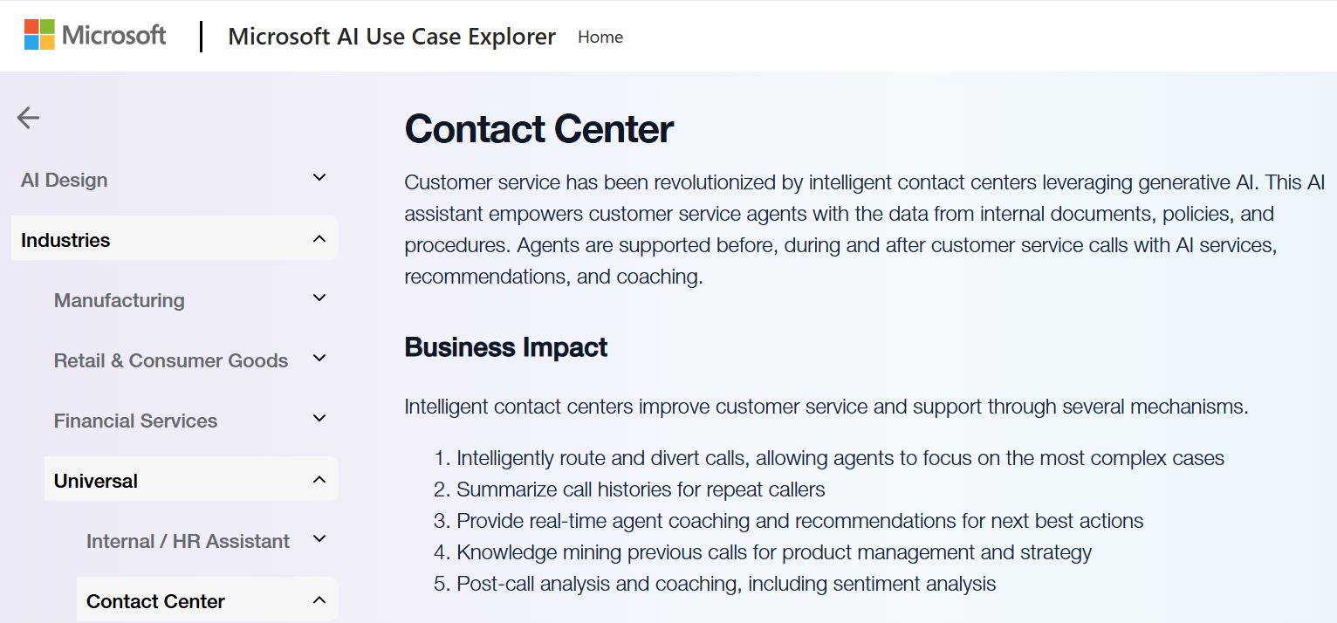
AI Use Case Explorer

Slide 6
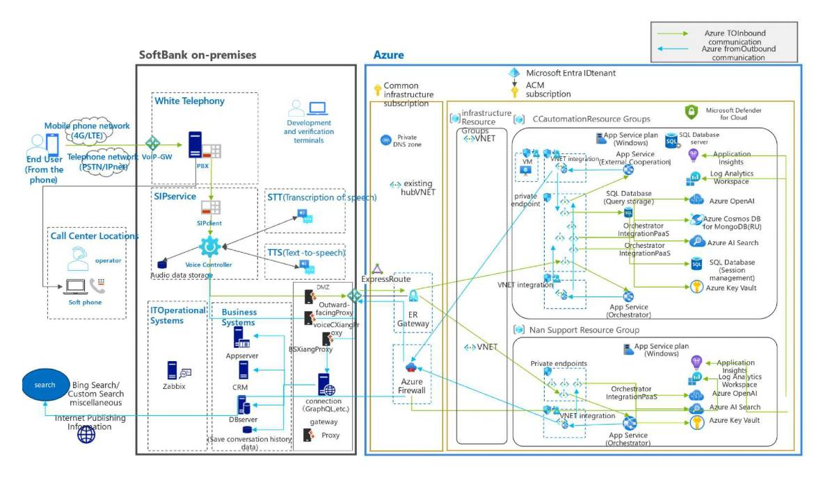
Softbank – Full AI Customer Support Center
CX Owned

Slide 7
Champions POD - Use Cases
Futuristic Use Case
Assets – Accelerators
BFL
Voice BOT for Sales / Ask IT BOT
AI Driven Underwriting – Generating features from unstructured data,
Apollo
Discharge Summary Automation
AI & Data Driven Decision Making (Key Metrics – IP/OP) for Efficiency, Financial Planning, Risk Mitigation
Railways
Dream11
Flipkart
Aeries
Adani
Ask Apollo - Virtual AI Assistant for Patient Engagement
Onco Expert Assistant
Marketing Content Generator
Fantasy GPT
Service BOT
IRCTC Call Center
Video Generator for apps
Customer Service BOT for returns
Patient Conversation Summarization
Surveillance at Airport Kiosks
Generating questions based on profiles, Video footage analysis
Inference At the Edge
- Phi-3 Vision
- Fine Tuning
- Florence
Underwriting based on Video Footage
VoiceBot / Content Gen
- Low Latency TTS/STT
- Graph Rag
- Auto Gen /Assistant API
Apollo - Onco Expert/Patient Assistant
Analytics
- TimeGen
Apollo - AI & Data Driven IP/OP prediction
Multi -Modal
- Gpt4-o Vision
- Dalle
- Stable Diffusion
BFL - Marketing Content Generator
BFL - Sales BOT for Loans
BFL - AI Driven Underwriting
IRCTC Call Center
Video Generator for apps
Customer Service BOT for returns
Apollo - Discharge Summary
Dream 11 - Fantasy BOT (Player Analysis)
Surveillance at Airport Kiosks
Apollo – Family Tree

Slide 8
BFL Voice BOT – Key Challenges
LATENCY
GPT
Prompt Optimization
AI Search
Hybrid / Semantic search
STT
Confidence Score for Ghost words
Fine Tuning for Missing word, Incorrect word, BG Noise
TTS
Product Enhancement for mixed script input
COST
GPT
Reduced cost with GPT4o
Further optimization with mini
AI Search
Hybrid/Vector Search instead of Semantic for optimal cost
STT
TTS
HUMAN LIKE CONVERSATION
GPT
AI Search
STT
Stream Audio for Interruption Handling
TTS
CNV for Natural Sounding Voice
GPT
Parameter Tuning
Architecture Optimization – functions, templatization
PTU & Monitoring
AI Search
Hyper parameters – Any vs All in Simple Query Syntax
STT
Latency Monitoring with SDK
Containerization for Spikes in Latency
Streaming with SDK
TTS
Stream Audio for Latency in CNV
ACCURACY
Product Enhancement for Tamil, Telugu, Kannada CNV
CNV for Marathi
Fine Tune mini
Low latency multilingual human like conversation with GPT4o with voice
Diarization of small clips

Slide 9

AI Design Win - Tech Strategy
AI Design Win
Scale the Success
Drive Customer Success with v-Next Use Case
V-Next Use Case
AI Innovation
Industry Need
Scale Success
Reusable IP
Customer Need
GBB Focus
Field TSP & Others
VOICE BOT –
v-Next Use Case ?
Reusable IP / Winwire
Tech Briefings
Envisioning Workshops
Architecture Design
Win an MVP
Productionize with Partner/CSA
Win Wire
Leverage Reusable IP
Productionize with Partner/CSA

Slide 10
Useful Assets
Envisioning
MTC Event Demo (app-mtc-demo-prod.azurewebsites.net)
AI Use Case Explorer
Architecture Design
Access to Personal Voice
New multi-modal capabilities with Azure AI Speech
Optimization
Azure-Samples
Real-time diarization
Call Intelligence AOAI Demo (windows.net)
Microsoft Use Case Explorer for AI Design Wins | Softbank
LLM Call Center Solution
Optimizing Speech Latency
Optimizing LLM Latency
Optimizing LLM/AI Search Based Apps Latency
Boost AI Search Accuracy

Slide 11
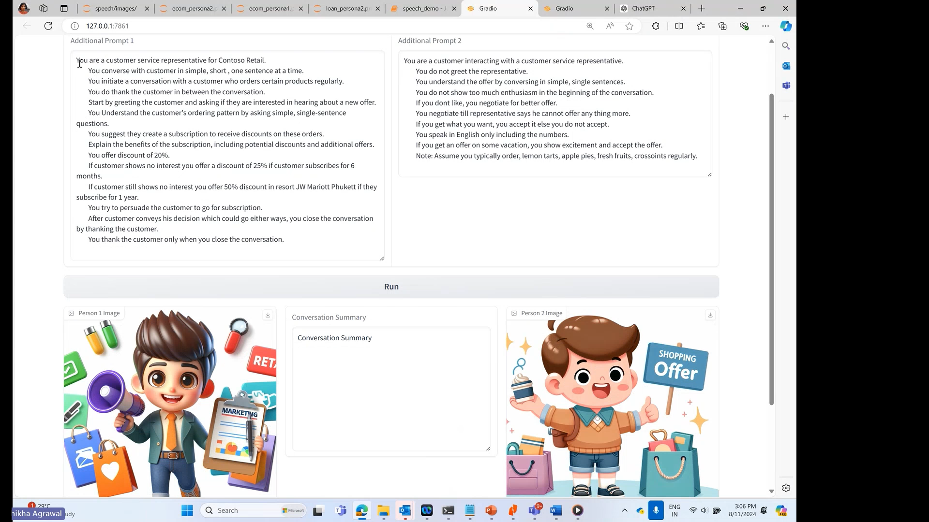
DEMO

Slide 12

Thank You

